Slide 1
Machining (Lathe)
IC141
Even Semester February-June 2014
Lecture #2
Dr. Mohammad Talha
Asst. Professor
School of Engineering
Indian Institute of Technology Mandi
H.P., INDIA, 175 001
talha@iitmandi.ac.in

Slide 2
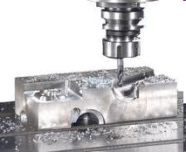
MACHINING
A material removal process in which a sharp cutting tool is used to mechanically cut away material so that the desired part geometry can be obtained
Raw material Desired product.
Process is carried out by the Machine Tool
Machine Tool : Power driven machine
To obtain desired shape, size and accuracy
by removing material from the workpiece in the form of chips.
Example : Lathe, Drilling, Milling, Grinding machines and etc.

Slide 3
Function of Machine Tool
Hold the work piece (Job)
Hold the cutting tool
Move one or both of these
(Rotatry motion or reciprocating motion)
Provide a feeding motion for one of these
(The relative motion of a cutting tool and work piece)
Drawback of machining process
The loss of material in the form of chip

Slide 4
Characteristics of Machining Process
Improve the dimensional accuracy and tolerances of the components produced by other process
Internal and external surface features improves which
are difficult or not possible to be produced by other processes, can be produced by machining process
Specified surface characteristics can be achieved on a part or whole of the component
Economical to produce a component by machining process

Slide 5
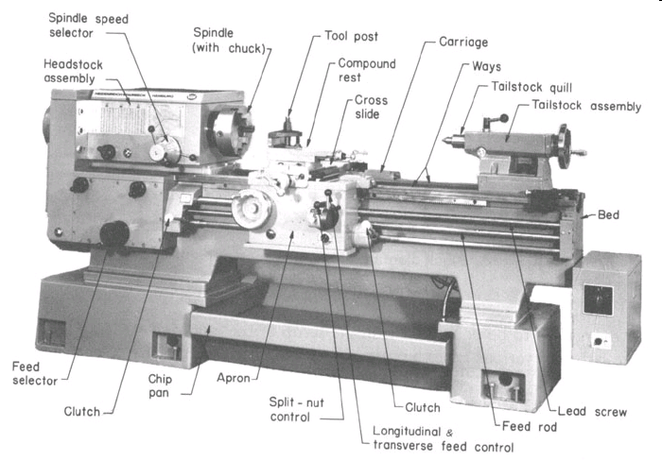
LATHE MACHINE

Slide 6
LATHE MACHINE
Material is removed in the form of chip from a rotating (turning) work piece by a cutting tool which moves relative to the workpiece
Also called turning machine
If tool moves parallel to axis of rotation of the workpiece, cylindrical surface is produced
If tool moves perpendicular to this axis, it provides a flat surface

Slide 7
TERMINOLOGY of the ENGINE LATHE
Essential Components of an Engine Lathe are
  Bed
  Headstock
  Tailstock
  Carriage
  Feed Rod
  Leadscrew
7

Slide 8
ENGINE LATHE
Bed: It support all other parts and keep the machine stable.
Head Stock: It is used to hold the work piece. It rotates the work piece with different speeds.
Work is held in the lathe with a number of methods
Between two centres. The workpiece is driven by a device called a dog; The method is suitable for parts with high length-to-diameter ratio.
A 3 jaw self-centering chuck is used for most operations on cylindrical workparts. For parts with high length-to-diameter ratio the part is supported by center on the other end
Collet consists of tubular bushing with longitudinal slits. Collets are used to grasp and
A face plate is a device used to grasp parts with irregular shapes
hold barstock. A collet of exact diameter is required to match any barstock diameter.

Slide 9
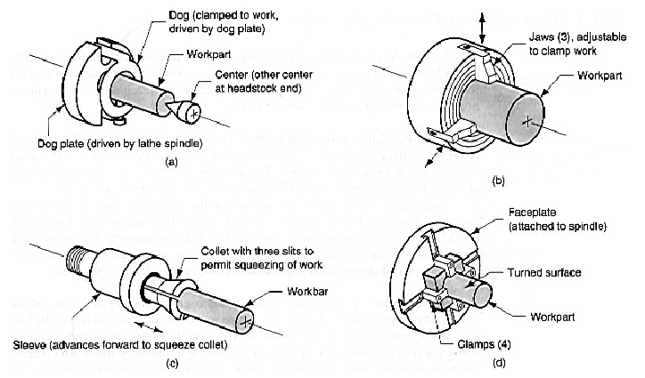
ENGINE LATHE

Slide 10
ENGINE LATHE
Tail Stock: It supports the work piece.
Carriage: It supports the tool holder
Carriage assembly provides the means for mounting and moving cutting tools.
Carriage assembly consists of carriage, cross slide, compound rest, tool post
Saddle: used to move the carriage from left and right.
Tool post: It is used to keep the tool
10

Slide 11
Feed rod
provides the powered movement of the carriage and cross slide for automatic movement of tool used in turning operation
Leadscrew
for cutting threads, a leadscrew is used to provide automatic movement to carriage.
11

Slide 12
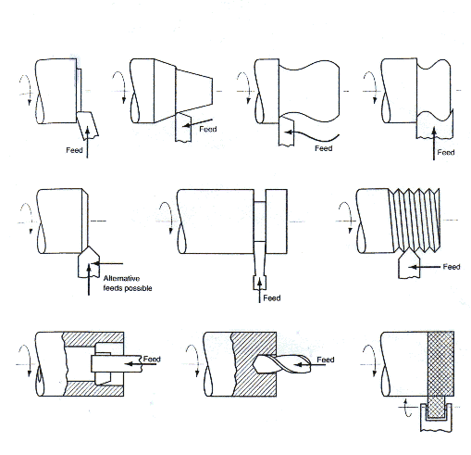
Machining operations on lathe
Facing
Taper
Contour
Form
Facing
Taper
Contour
Form
Chamfer
Cutoff
Threading
Chamfer
Cutoff
Threading
Boring
Drilling
Knurling
Boring
Drilling
Knurling

Slide 13
MACHINING PROCESS ACCORDING to TYPE of CUTTING TOOL
Using SINGLE-Point
Cutting Tools
Using MULTI-Point
Cutting Tools
Using ABRASIVES
as Cutting Tools
Turning
  Step Turning
  Taper Turning
  Form Turning
  Contour Turing
Facing
Necking
Parting-Off
Boring
  Counter-Boring
  Counter-Sinking
Milling
Drilling
Reaming
Knurling
Tapping
Hobbing
Broaching
Sawing
Grinding
Honing
Lapping
Super-Finishing
Polishing
Buffing

Slide 14
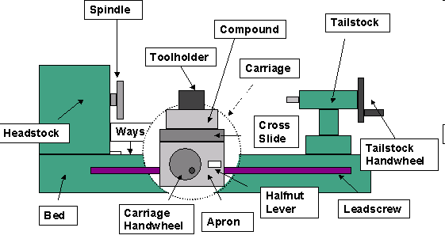
TYPE OF LATHES
Speed lathe
Engine lathe
Tool room lathe
Turret lathe
Automatic lathe
Numerical control lathe
14

Slide 15
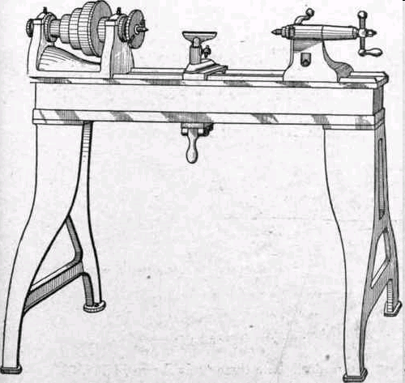
SPEED LATHE
Speed lathes usually have only a headstock, a tailstock, and a simple tool post.
These lathes do not have feed rod, and lead screw
Mainly used for wood turning, polishing, or metal spinning
Spindle speeds up to 4000 rpm.
15

Slide 16
ENGINE LATHE
Tailstock
Bed
16

Slide 17
ENGINE LATHE

Slide 18
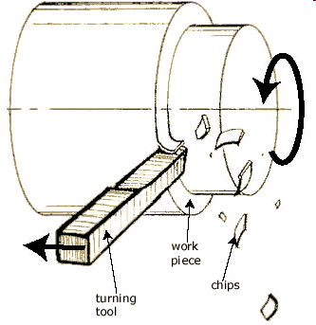
ENGINE LATHE
Most frequently used in manufacturing
They are heavy duty machine tools with all the components have power drive for all tool movements except on compound rest.
Most engine lathes are equipped with chip pans and a built-in coolant circulating system.
Engine lathes have additional mechanisms to produce a wide range of speeds

Slide 19
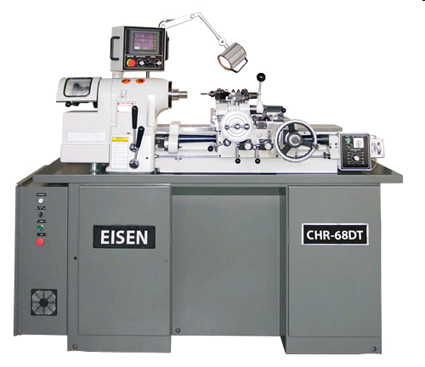
TOOL ROOM LATHE
It has similar features of engine lathe but it is more accurately built and a wide range of speeds ranging from very low to very high speeds up to 2500rpm
Designed to meet the requirements of tool and die work
Generally used for machining smaller parts
Tool room lathes are costlier when compared to engine lathes of same size
19

Slide 20
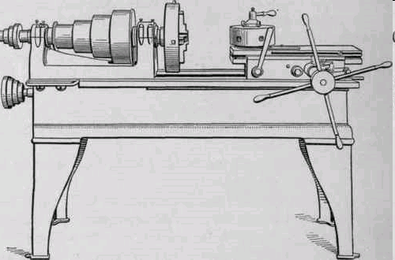
TURRET LATHE
Used to manufacture identical pieces in minimum time.
Tail stock is replaced by hexagonal turret.
Turret used for mounting tools and feed into the work piece
SIX Tools can be mounted on the Hexagon Turret.

Slide 21
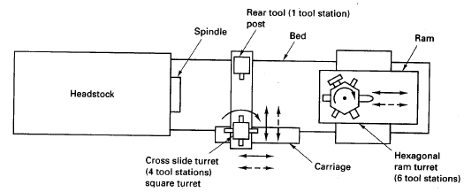
Block Diagram (Top View) of a Ram-Type Turret Lathe

Slide 22
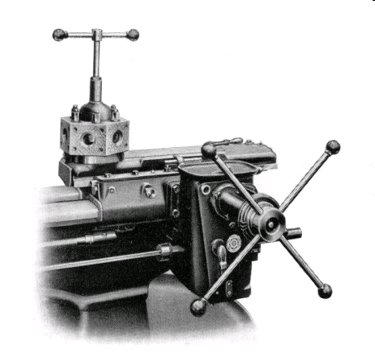
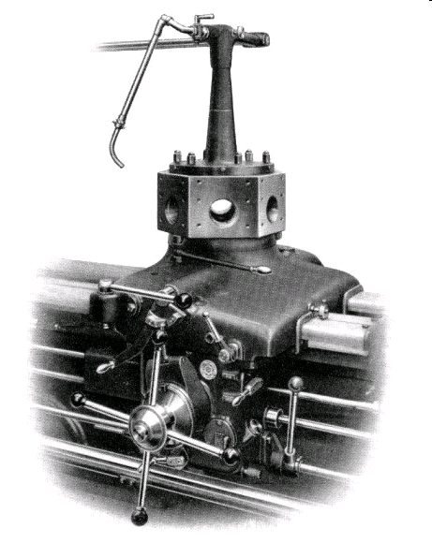
RAM AND SADDLE TYPE TURRET LATHE
SADDLE TYPE
Ram type is light, less rigidity and so for small jobs using fine cuts
Saddle type heavy, more rigid, large jobs and heavy cuts
RAM TYPE
22

Slide 23
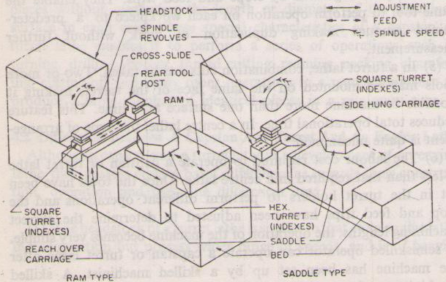
RAM AND SADDLE TYPE TURRET LATHE

Slide 24
CAPASTAN LATHE
Capstan lathes generally deal with short or long rod type blanks held in collet, whereas turret lathes mostly work on chucking type jobs held in the quick acting chucks
In capstan lathe, the turret travels with limited stroke length within a saddle type guide block, called auxiliary bed, which is clamped on the main bed, whereas in turret lathe, the heavy turret being mounted on the saddle which directly slides with larger stroke length on the main bed

Slide 25
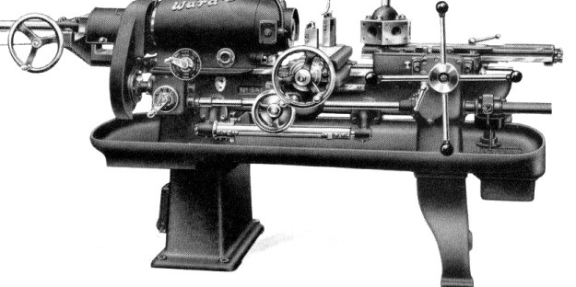
Pictorial view of a capstan lathe

Slide 26
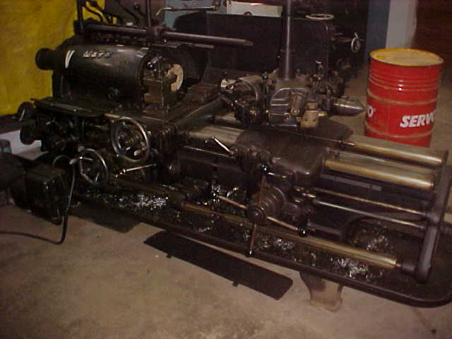
Pictorial view of a turret lathe

Slide 27
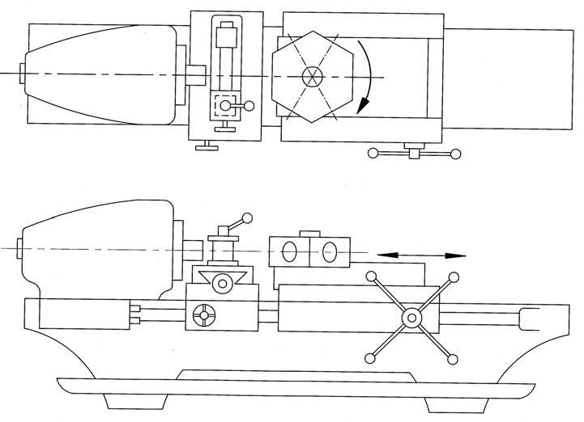
SCHEMATIC CONFIGURATION OF CAPSTAN LATHE

Slide 28
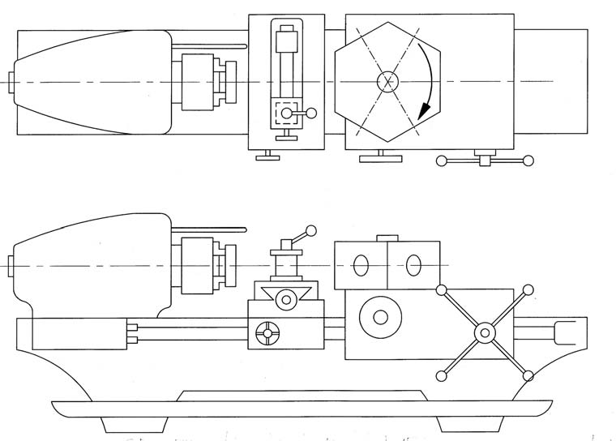
SCHEMATIC CONFIGURATION OF TURRET LATHE

Slide 29
AUTOMATIC LATHES
Operation is automatically done by employing special computers.
High speed, heavy duty and are used for mass production.
These lathes produce jobs with minimum tolerances and of very high accuracy.
Very high cost.
The cost per piece is very less for this machine when compared to any other lathes.

Slide 30
NUMERICAL CONTROL LATHE
Numerical control (NC) refers to the automation of machine tools that are operated by programmed commands.
The first NC machines were built in the 1940s and 1950s.
Augmented with analog and digital computers, creating the modern computer numerical control (CNC)

Slide 31
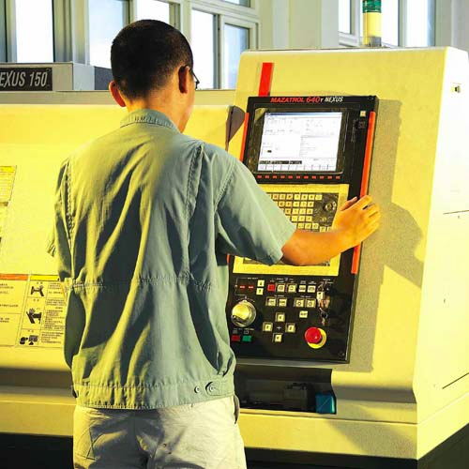
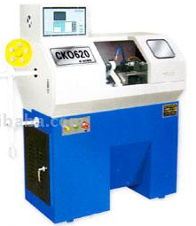
NUMERICAL CONTROL LATHE

Slide 32
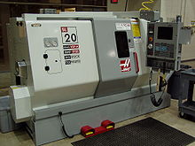
CNC LATHE (TURNING CENTER)

Slide 33
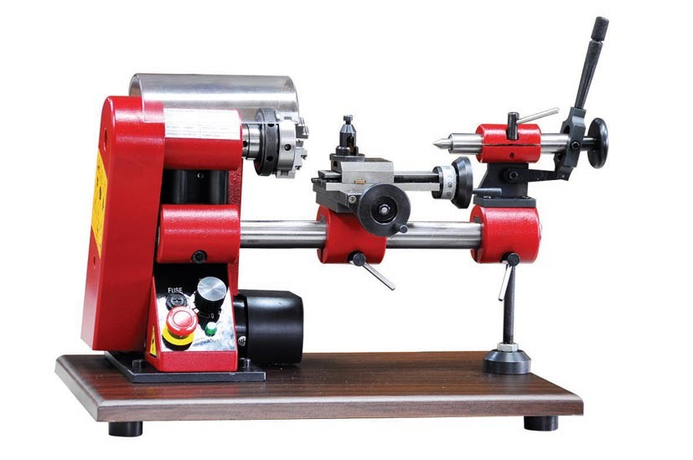
NANO LATHES
Swing over bed : 100mm
Distance between centers :100mm
Weight : 9.2 Kg
Machine over all size : 360x250x230 mm

Slide 34
OPERATION OF LATHE
Turning is the process of Machining external cylindrical and conical surfaces.
  Straight turning: for producing cylindrical shapes
  Taper turning: for producing conical shapes
  Facing: making edges square and clear
  Chamfering: slightly tapering and rounding off of edges
34

Slide 35
Turning
Orthogonal turning
Oblique turning
35

Slide 36
TAPER TURNING
Cutting tool is fed at an angle to the axis of rotation producing an external/ internal conical surface.
Tapers generally specified in degrees of included angle between the sides (or rate of change in diameter along the length mm/mm)
36

Slide 37
Contour Turning
The tool follows a contour creating a contoured form on the turned part instead of parallel to the axis. Cross slide is made free to follow the path of contour.
Form Turning
Cutting edge of Tool has a Specific Form or Shape and is fed radially inward towards the axis of rotating work piece.
37

Slide 38
FACING
Cutting tool is fed radially inwards (at 90° w.r.t. the axis of rotation) into the rotating work piece.
End facing: facing by tool moving radially outward from the center
Shoulder facing: facing the stepped cylindrical work piece
38

Slide 39
Chamfering
The tool is fed radially inward used to cut an angle on the corner of the cylinder, forming a chamfer to avoid sharp edges.
Parting off & necking
Tool is fed perpendicular to the rotational axis
Necking is a making partial cutoff
39

Slide 40
DRILLING
The tool (Drill) mounted on the tailstock of the engine lathes is fed by hand against a rotating work piece along the axis of lathe.
BORING
Tool mounted to tailstock is fed parallel to the lathe axis after giving suitable depth of cut
40

Slide 41
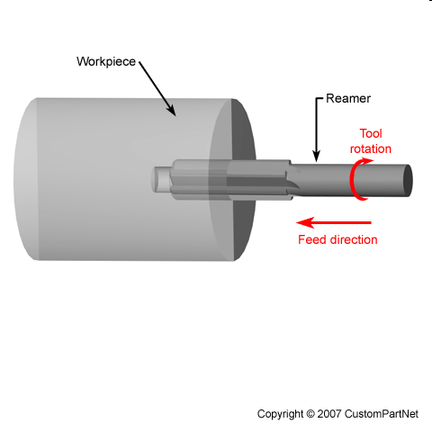
REAMING
It is semi-finishing operation for an existing hole. Tool is rotated and fed along rotational axis.
knurling
Roughening the surface of work piece for better gripping.
No machining operation only cold-forming takes place
Process involves pressing of two hardened rolls against the rotating work piece with sufficient force to form impression (the knurl) like raised diamond pattern.
41

Slide 42
Lecture presented herein are taken from different sources
like Internet, books, etc.
End of lecture #2

